Slide 1

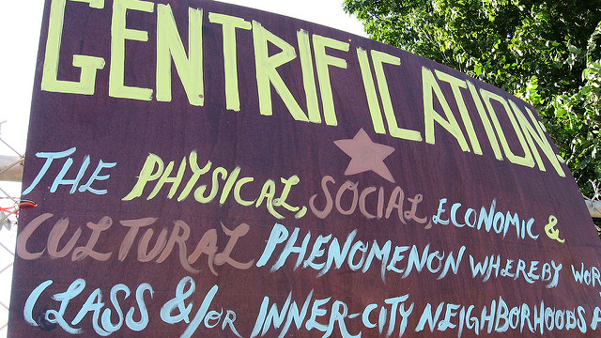
GentRIFICATION OF RICHMOND
THE CORRELATION BETWEEN THE CITIES GENTRIFIED NEIGHBORHOODS, CRIME RATES, & COST OF HOUSING
U of R Data Analytics Bootcamp
Project #1- September 2021
Notes:
Our team chose to study the topic of gentrification in the City of Richmond and its correlation to some of the factors within the region.

Slide 2




TEAM SOCIOTRACKER
Joseph March
Angela Angulo
Marisa Kiger
Bonnie Bailey
Notes:
We are Team Sociotracker which is made up of Joseph March, Angela Angulo, Marisa Kiger, and myself Bonnie Bailey.

Slide 3

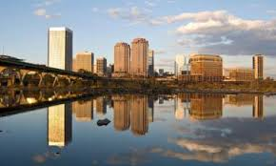

Gentrification- the process whereby the character of a poor urban area is changed by wealthier people moving in, improving housing, and attracting new businesses, typically displacing current inhabitants in the process. https://languages.oup.com/google-dictionary-en/
Notes:
For those of you who are not familiar with the topic of gentrification, it is ultimately taking a typically low to middle income region or neighborhood and having an influx of renovation, remodeling, new construction, commercial business, etc. All of which cause the property values, rents, mortgages to increase. Essentially, it forces the population out of their homes because they can no longer afford to stay where they are. It prevents low income families from moving into or remaining in previously affordable neighborhoods.

Slide 4

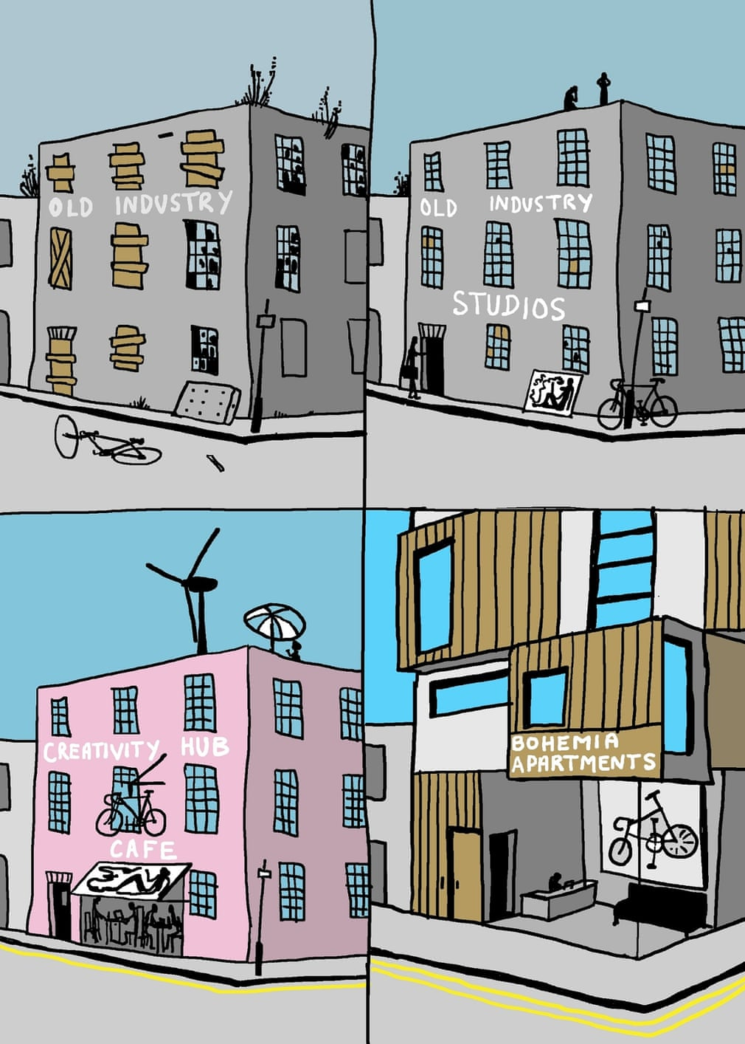
MOTIVATION & SUMMARY Hypothesis: An expectation that crime reported will decrease as average housing values increase for neighborhoods. Research Questions: -How does gentrification affect crime rates? -how does the rate of crime correlate to the cost of housing?
WHY DID WE ASK THESE QUESTIONS:
Gentrification is not something that occurs overnight. It is a process over time. Our study is to determine whether or not crime rates were affected throughout this time frame by looking at trends over multiple years. Then to determine how the cost of housing in these gentrified areas correlated to that crime rate.
SUMMARY:
While there is a weak negative correlation between housing values and crime rate in all of Richmond overall, we do see patterns arise among the 7 gentrified neighborhoods we reviewed.
Notes:
So our overall hypothesis and expectation of this study was that we would see the same data across all neighborhoods. That as the housing value increased, the crime rate would decrease. We chose to pursue the following Research Questions:
How does gentrification affect crime rates?
How does the rate of crime correlate to the cost of housing?
Gentrification is not a slow process. It takes years and years to make the changes. We focused on the trends over a multiple year spread (2000-2020) so that even if an area had not completed its cycle of gentrification, it would have at least begun to experience the changes that come with urban development.
There is a weak correlation between housing values and crime rates in Richmond overall- but we found some patterns in our defined scope which we will get into now.

Slide 5
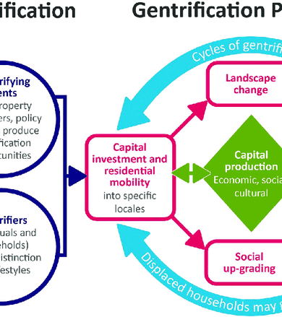
QUESTIONS & DATA
Data pulled on crime rates and housing prices based on neighborhoods in Richmond.
Resources:
Crime Data- https://www.richmondgov.com
Zillow- https://www.zillow.com/research/data/
Google Maps/Street View
Census Data- https://www.census.gov/quickfacts/fact/table/richmondcitycountyvirginia,richmondcityvirginia/PST045219
Mapline- https://mapline.com/
Notes:
We first pulled Crime Data from the Richmondgov website. The data ran for our 20 year window and looked at both violent and non-violent crimes. The data took into account homicide, sex offenses, robbery, and more. We then pulled housing values from Zillow CSV files and used Census data on neighborhood tracts which we overlaid onto Google maps to determine our scope.

Slide 6
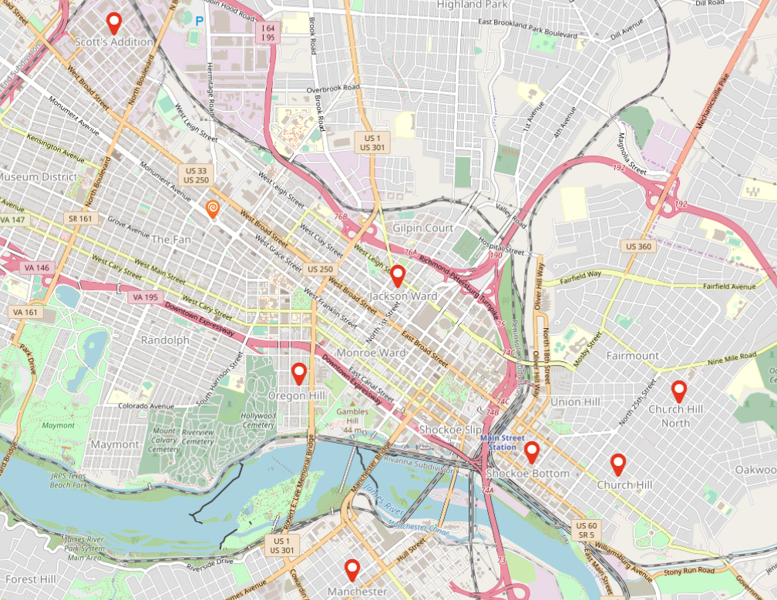
Process
Due to the large amount of data, we chose to narrow the field to 7 of the regions that have shown the most gentrification and growth since the Year 2000:
Shockoe Bottom
Scott’s Addition
Church Hill
Church Hill North
Oregon Hill
Manchester
Jackson Ward
Notes:
Once the data was compiled, the City of Richmond was comprised of about 150 different neighborhoods which was a huge amount of data. We narrowed our scope to 7 neighborhoods that have undergone the most recent and drastic changes from gentrification since the year 2000. Shockoe Bottom, Scott’s Addition, Church Hill, Church Hill North, Oregon Hill, Manchester, and Jackson Ward.
Now Joseph is going to go into more detail about the Jupyter notebook and walk you through some of our coding and data cleanup.

Slide 7
Refer to the Jupyter Notebook located in our GitHub Project Repository:
https://github.com/designergal3002/Team-Sociotracker/blob/main/sociotracker_AngelaCopy.ipynb
Jupyter Notebook: Sociotracker (currently called sociotracker_AngelaCopy.ipynb)
Uploads crime data by year from https://www.richmondgov.com
Adds Total Crime and Percent Change columns to the crime data.
Runs a function we created to select a location from the crime data and build a DataFrame showing all years from 2000 – 2020 as rows.
Creates a combined DataFrame of the average crime data for all of Richmond.
Uploads Average House Prices by month per Neighborhood from Zillow.
Converts Zillow data into Average House Prices per year from 2000 – 2020.
Runs a function we created to select a location from the Zillow data and provide Average House Prices per year and Price Percent Change in a new DataFrame, to be merged with crime DataFrame later.
Pulls crime and average house price data for Church Hill, Church Hill North, Jackson Ward, Manchester, Scott’s Addition, Shockoe Bottom, and Oregon Hill as well as the averages for Richmond as a whole using functions we made.
Saves all pulled data as csv files for use in plotting code via different Jupyter Notebook.
Calls Census API to pull per capita income by zipcode (not used in the long run due to inability to match either zipcode or tracts with Richmond neighborhoods).
DATA CLEANUP & EXPLORATION

Slide 8
DATA CLEANUP & EXPLORATION
Refer to the Jupyter Notebook located in our GitHub Project Repository:
https://github.com/designergal3002/Team-Sociotracker/blob/main/CrimeTypeData.ipynb
Jupyter Notebook: Crime Type Data (currently called CrimeTypeData.ipynb)
Uploads the data saved as csvs from the prior notebook (all locations and Richmond as a whole).
Creates a new DataFrame that shows the violent vs. non-violent crime for each location for both 2000 and 2020.
Refer to the Jupyter Notebook located in our GitHub Project Repository:
https://github.com/designergal3002/Team-Sociotracker/blob/main/Scatter_data.ipynb
Jupyter Notebook: Scatter Data (currently called Scatter_data.ipynb)
Uploads the original crime data and Zillow data for all neighborhoods in Richmond.
Creates a new DataFrame showing 2000, 2010, and 2020 Total Crime and Average House Price
Refer to the Jupyter Notebook located in our GitHub Project Repository:
https://github.com/designergal3002/Team-Sociotracker/blob/main/Scatter_data2.ipynb
Jupyter Notebook: Scatter Data 2 (currently called Scatter_data2.ipynb)
Rewrite of scatter data that pulls for all years.
Refer to the Jupyter Notebook located in our GitHub Project Repository:
https://github.com/designergal3002/Team-Sociotracker/blob/main/Percent_change.ipynb
Jupyter Notebook: Percent Change (currently called Percent_change.ipynb)
Added calculation for percent change over time of crime and housing data

Slide 9
Data Analysis
Refer to the Jupyter Notebook located in our GitHub Project Repository:
https://github.com/designergal3002/Team-Sociotracker/blob/main/sociotracker_graphs_working.ipynb
1- SCATTER PLOT- TOTAL CRIME VS AVG HOUSE VALUE 2000-2020
2- LINE GRAPH- ALL NEIGHBORHOODS IN RVA AVG HOUSE VALUE 2000-2020
3- LINE GRAPH- ALL NEIGHBORHOODS IN RVA REPORTED CRIME 2000-2020
4- CRIME BAR ANALYSIS- 2000-2020
5- LINE GRAPHS- CRIME VS HOUSING VALUE 2000-2020
GRAPH REPRESENTING EACH OF OUR 7 PRIMARY NEIGHBORHOODS
6- BOX & WHISKER ANALYSIS- CRIME & AVG HOUSE VALUE 2000-2020

Slide 10
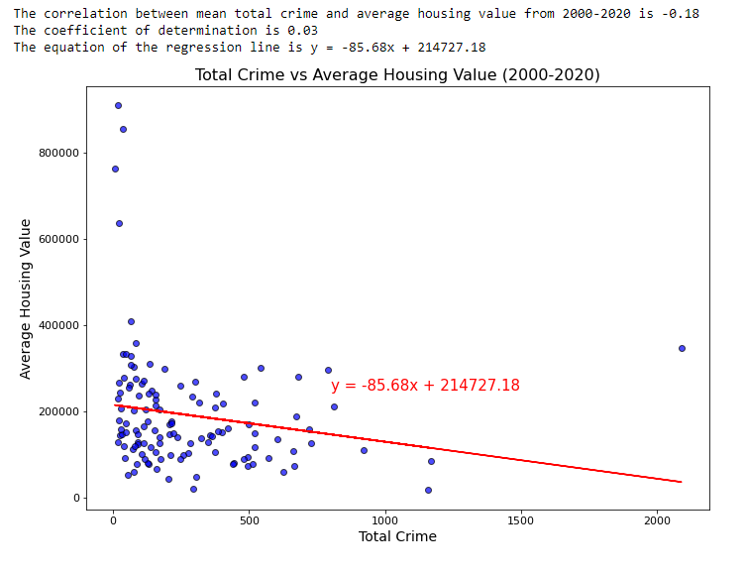

Scatter Plot- Total Crime vs Average House Value 2000-2020 Expected Outcome - strength of correlation >0.7 Summary Evaluation- Strength of Correlation -0.18 = Very weak correlation
Notes:
Outliers affecting the overall correlation.

Slide 11
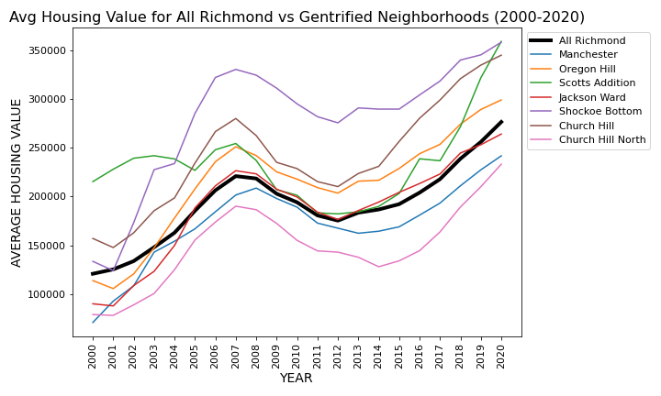
Line graph- all neighborhoods IN RVA Avg House value 2000-2020 Black line- Richmond used as Control Summary evaluation- All Neighborhoods showed an increase in average home value price. Noted: some changed at different rates.
Notes:
Important to mention- Dip between 2008- 2012 correlates to the housing crisis balloon.

Slide 12
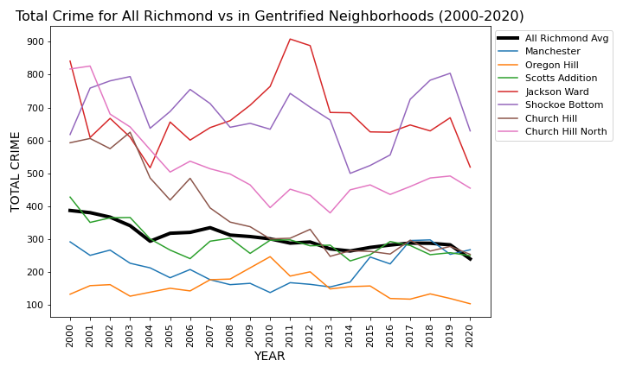
Line graph- all neighborhoods IN RVA reported Crime 2000-2020 Black line- Richmond used as Control Summary evaluation- All Neighborhoods showed a decrease in crime, with the exception of Manchester and Shockoe Bottom.
Notes:
All areas showed a reduction in crime, except for Manchester and Shockoe Bottom.
The data collected for this study does not provide additional insights necessary to determine what factors affected Manchester crime.

Slide 13
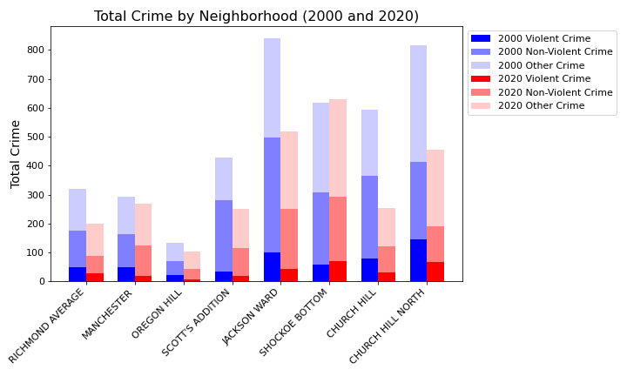
Crime bar analysis- 2000-2020 Expected Outcome - reduction in violent crimes and increase in non-violent crime. Formula used = Violent Crimes (Homicide, Sex Offense, Robbery, and Assault), Non-Violent Crimes (Burglary, Theft, Vice, and Vehicle Theft), and Other. All neighborhoods decreased in both violent and non-violent crime except for Shockoe Bottom.
Notes:
Shockoe Bottom showed a slight increase in violent crimes 2020 = 59 reports and 2020 = 70 reports. The most reported violent crime was assault.

Slide 14
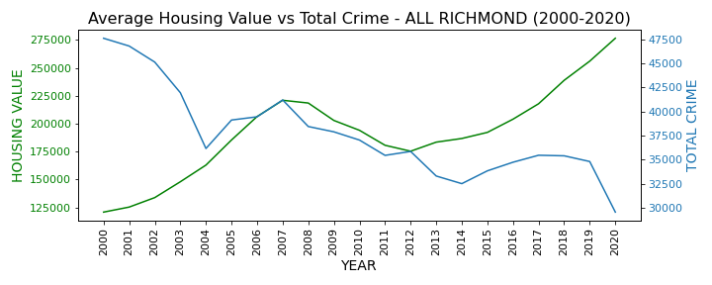
Line graph- Crime vs avg Housing Value 2000-2020 Expected Outcome - inverse relationship.

Slide 15
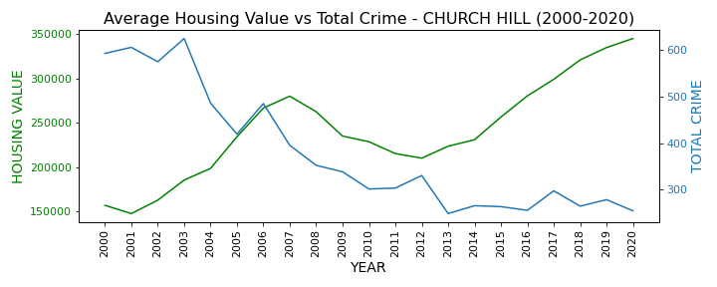
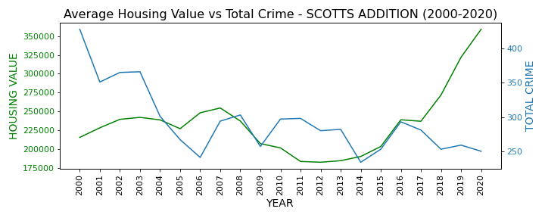
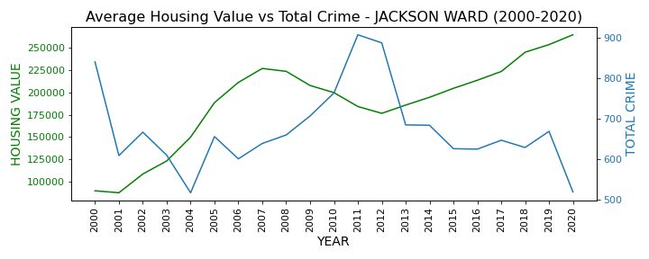
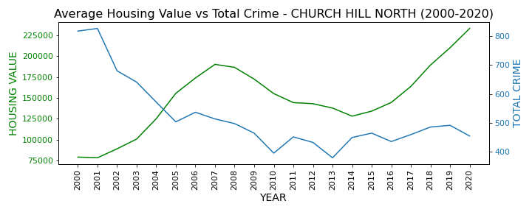
SUMMARY OUTCOME- THESE NEIGHBORHOODS (SCOTTS ADDITION, CHURCH HILL & CHURCH HILL NORTH, AND JACKSON WARD) SHOWED THE EXPECTED OUTCOME

Slide 16
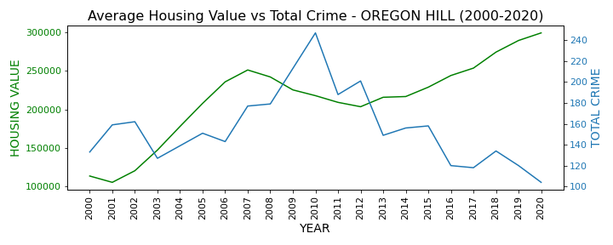
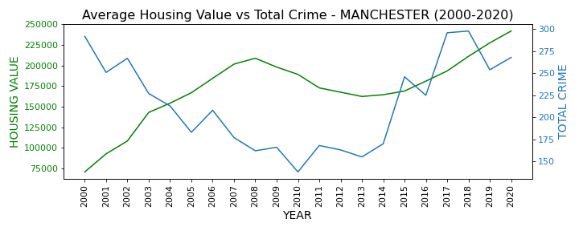
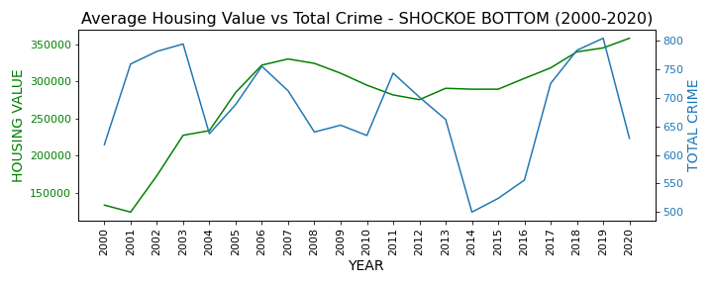
SUMMARY OUTCOME- THESE NEIGHBORHOODS (MANCHESTER, OREGON HILL, AND SHOCKOE BOTTOM) DID NOT SHOW THE EXPECTED OUTCOME.
Notes:
Manchester shows slight increase in crime. Further studies necessary to determine factors influencing crime in Manchester.

Slide 17
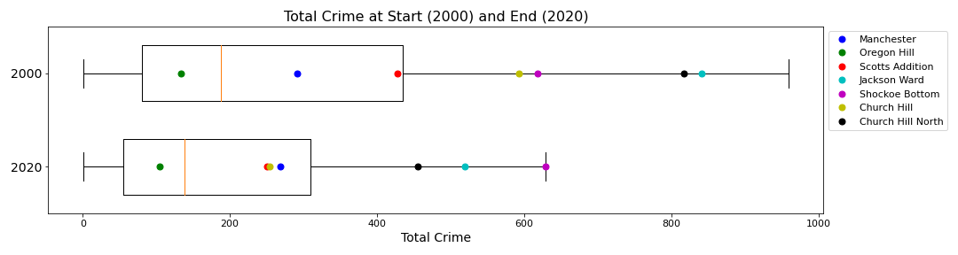
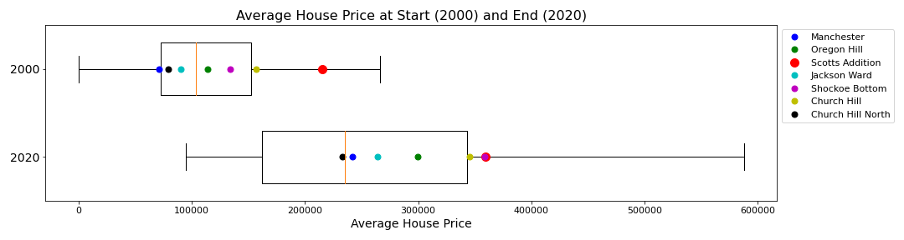
Box and Whisker analysiS- CRIME & AVG HOUSE VALUE 2000-2020 Expected Outcome – Relatively similar distribution of neighborhoods from 2000-2020. Overall expected outcome was seen for housing, but not for crime.

Slide 18
Discussion
DISCUSSION
Findings-
The overall correlation was weak between total crime and average house value for Richmond as a total.
4 of the 7 selected neighborhoods did show an inverse relationship between the total crime rate and average house value.
3 of the 7 selected neighborhoods did not behave as expected.
Conclusion-
We did not find what was expected in each case, potentially because neighborhoods are developing at different rates. Location and distance from the city center may also affect results. Percentage of commercial real estate vs residential could have impacts as well.
Notes:
As I stated at the start of our presentation, our expectation was that all neighborhoods would have data that acted similarly in that as housing values increased, crime rates would go down. This was not what we found.
4 of the 7 (Scott’s Addition, Church Hill, Church Hill North, Jackson Ward) all did show the expected inverse relationship.
However, 3 of the 7 (Manchester, Oregon Hill, Shockoe Bottom) did not. We can attribute these differences to the fact that these neighborhoods did not all begin gentrification at the same time and did not develop at the same rate. Location and distance may have played a role, as well as how much of the neighborhood became commercial development vs residential space.

Slide 19
POST MORTEM
Difficulties That Arose:
Time barriers
Differences in source data
Additional Questions That Arose:
Are other factors contributing to crime such as poverty rate, population, and residential demographics
How did the overall demographics of homeowners and business owners change as the neighborhoods developed.
What we would study next (If we had 2 more weeks):
Pull more meaningful information from Census data.
Find statistics on what type of commercial development had occurred within each neighborhood.
Determine population demographics at beginning and end.
Notes:
Throughout the study, the obvious barriers were the time restraint for our 2 week project. Another was the varying data based on the source that we chose to adopt.
Additional Questions- Several other factors come into play with gentrification and we would love to have seen the impacts that those had on this study. Other factors such as population, demographics, household income, etc.
Also- how did the demographics change as the neighborhoods developed?
If we had additional time, we would most certainly want to pull more data from the Census and potentially utilize their API.
We would like to find stats on the type and amount of commercial development took place within each neighborhood. What percentage of the neighborhood was commercial prior compared to now? And finally we would like to study further into the population demographics through the gentrification process.
That is the completion of our presentation, does anyone have any questions?

Slide 20

QUESTIONS?

